Slide 1

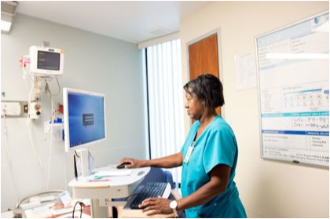
Come Grow With Us
The Career Opportunity You Deserve!
The Support You Desire!

Slide 2
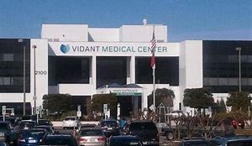
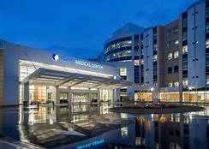

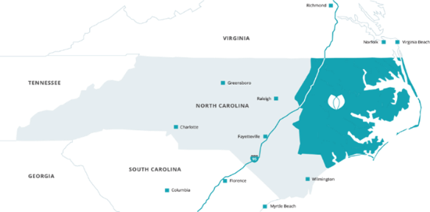
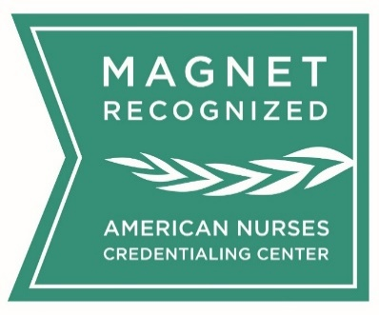
Vidant Medical Center – Greenville, NC
Vidant Medical Center, one of four academic medical centers in North Carolina, is the flagship hospital for Vidant Health and serves as the teaching hospital for the Brody School of Medicine at East Carolina University.
974 Licensed Beds
7,000 + Employees
2,487 Nurses

Slide 3
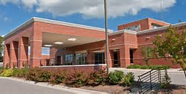
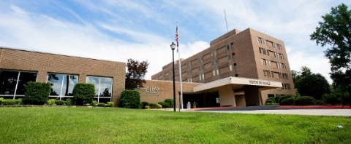
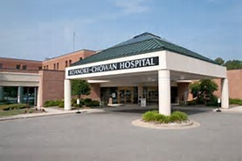
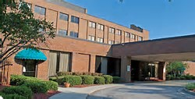
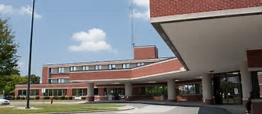
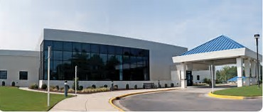
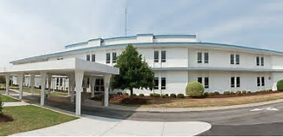
Vidant Health System
Vidant Health Hospitals-Locations
Vidant Beaufort Hospital Washington, NC 142 Licensed Beds
Vidant North Hospital
Roanoke Rapids, NC 204 Licensed Beds
Vidant Roanoke-Chowan Hospital
Ahoskie, NC 114 Licensed Beds
Vidant Edgecombe Hospital
Tarboro, NC 117 Licensed Beds
Vidant Duplin Hospital
Kenansville, NC 81 Licensed Beds
Vidant Bertie Hospital
Windsor, NC 6 Licensed Beds
Vidant Chowan Hospital
Edenton, NC 25 Licensed Beds

Slide 4
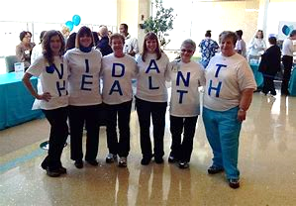
Vidant Health Team Benefits
Medical, Dental, Pharmacy, and Vision Coverage
Employee Pharmacy Access
Employee Clinic with Medcost Plan
Vidant Now (Virtual Webcam Care)
Hospital Bill Discount with Medcost Plan
Short Term and Long Term Disability Insurance
Life Insurance (Self, Spouse, Dependents)
PTO – Paid Time off for Vacation, Holidays, Sickness
Vidant Wellness Center Reduced Membership Rate
401k Retirement Plan (with matching)
NA I to NA II Program
Tuition Reimbursement Assistance
Holiday Savings Club
Employee Assistance Program
Notes:
Health, dental and vision insurance start the first day of employment
In addition, we offer:
A 401k retirement plan
Life and disability insurance
Reimbursement accounts
Vacation
Paid holidays (nine)
Sick leave (12 days annually)
Competitive salary (evaluated annually)
Shift and weekend differentials
The R.I.S.E. Program
Relocation Assistance
Tuition Reimbursement
Holiday Savings Club
An Employee Pharmacy
The Vidant Employee Clinic
Reduced membership fee for Vidant Wellness Center

